Slide 1
Hypothesis Testing

Slide 2
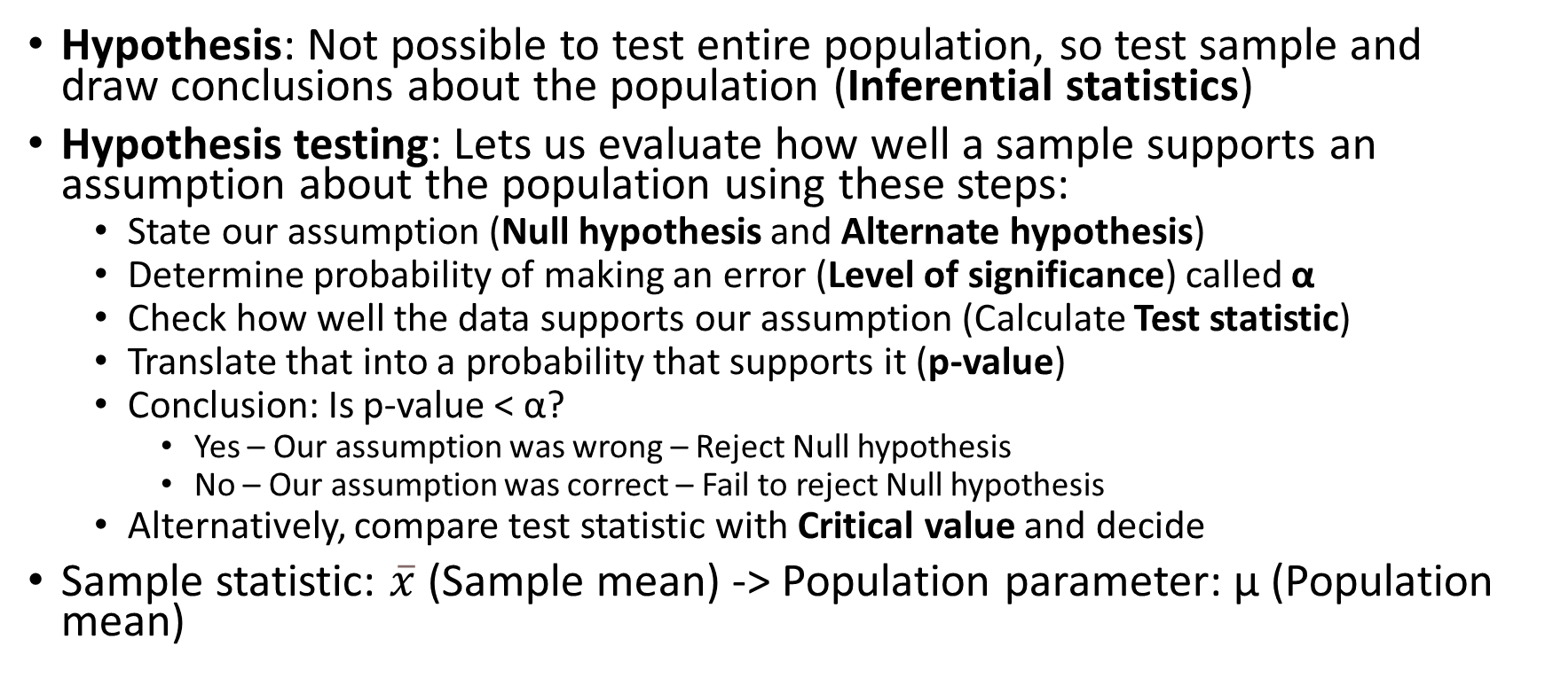
Hypothesis
Hypothesis: Not possible to test entire population, so test sample and draw conclusions about the population (Inferential statistics)
Hypothesis testing: Lets us evaluate how well a sample supports an assumption about the population using these steps:
State our assumption (Null hypothesis and Alternate hypothesis)
Determine probability of making an error (Level of significance) called α
Check how well the data supports our assumption (Calculate Test statistic)
Translate that into a probability that supports it (p-value)
Conclusion: Is p-value < α?
Yes – Our assumption was wrong – Reject Null hypothesis
No – Our assumption was correct – Fail to reject Null hypothesis
Alternatively, compare test statistic with Critical value and decide
Sample statistic: $\overline{x}$ (Sample mean) -> Population parameter: μ (Population mean)

Slide 3
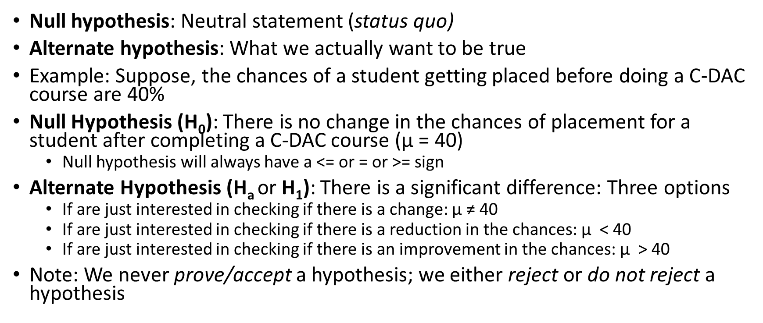
Null and Alternate Hypotheses
Null hypothesis: Neutral statement (status quo)
Alternate hypothesis: What we actually want to be true
Example: Suppose, the chances of a student getting placed before doing a C-DAC course are 40%
Null Hypothesis (H₀): There is no change in the chances of placement for a student after completing a C-DAC course ($\text{μ}$ = 40)
Null hypothesis will always have a <= or = or >= sign
Alternate Hypothesis (H_{a} or H₁): There is a significant difference: Three options
If are just interested in checking if there is a change: $\text{μ}$ ≠ 40
If are just interested in checking if there is a reduction in the chances: $\text{μ}$ < 40
If are just interested in checking if there is an improvement in the chances: $\text{μ}$ > 40
Note: We never prove/accept a hypothesis; we either reject or do not reject a hypothesis

Slide 4
Significance Level (α) and p-value
α: What we set before a statistical test
p-value: What we calculate after the test
α = Significance level = Threshold or acceptable probability of rejecting the null hypothesis when it is actually true
Usually set to 5% (or 0.05)
Meaning: We are okay with a 5% chance of rejecting the null hypothesis incorrectly
Why not keep it at 0%? => We would never reject H₀!
p-value = Result of an actual test (Area of rejection)
Low p-value: Reject H₀, High p-value: Fail to reject H₀
So, we may start with α = 0.05, run a test, and calculate p-value
If p-value = 0.02, Reject H₀
If p-value = 0.10, Do not reject H₀
If p-value <= α … Reject H0
If p-value > α … Do not reject H0

Slide 5
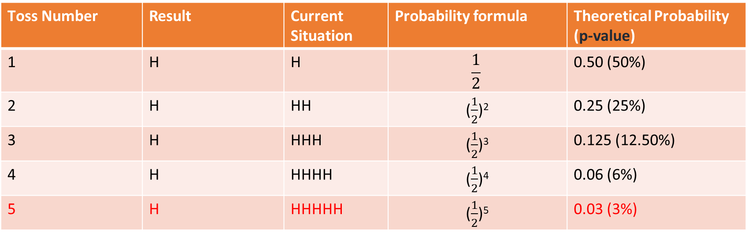
Significance Level (α) and p-value
Example: Tossing a coin with H₀ = Coin is fair and H₁: Coin is not fair
We toss it 5 times and each time we get a head! (See next slide for a bar plot)
At what point we conclude that the coin is not fair and reject H₀?
That is our significance level (α), usually set at 0.05 (i.e. 5%) or 0.10 (0r 10%) – Our Lakshman Rekha! Our p-value must be > α for us not to reject H₀
If we have set it at 5%, if we get a heads a fifth time, the p-value < α and we reject H₀
Toss Number | Result | Current Situation | Probability formula | Theoretical Probability (p-value)
1 | H | H | $$\frac{1}{2}$$ | 0.50 (50%)
2 | H | HH | ($\frac{1}{2}$)² | 0.25 (25%)
3 | H | HHH | ($\frac{1}{2}$)³ | 0.125 (12.50%)
4 | H | HHHH | ($\frac{1}{2}$)⁴ | 0.06 (6%)
5 | H | HHHHH | ($\frac{1}{2}$)⁵ | 0.03 (3%)

Slide 6
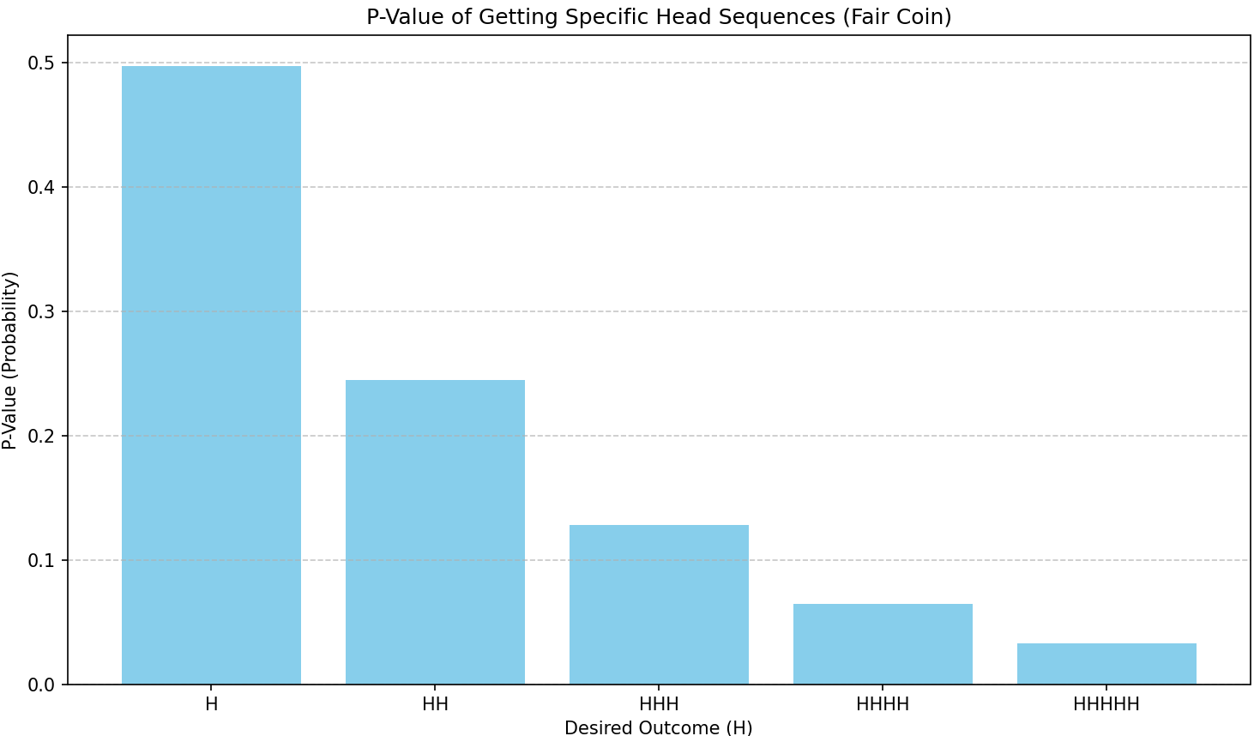
Visualizing p-value

Slide 7
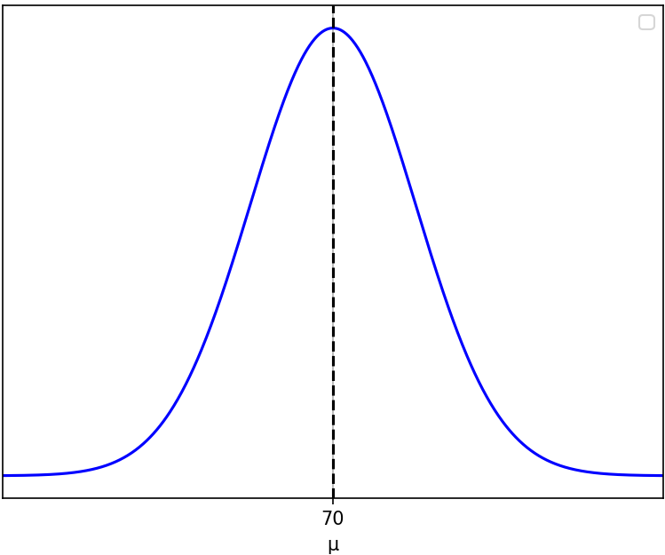
Significance Level (α) – More Details
α: The probability of rejecting the null hypothesis even though it is true (Type I Error)
Why? What if the coin was indeed fair and showed HHHHH? – Very rare but possible!
We ended up rejecting H0 when we should not have! => Type I error
Another Example: A course head thinks average student score is 70%
H₀: Population mean score (μ) = 70%, H₁: Population mean score (μ) ≠ 70%
So, scores distribution should look like this

Slide 8
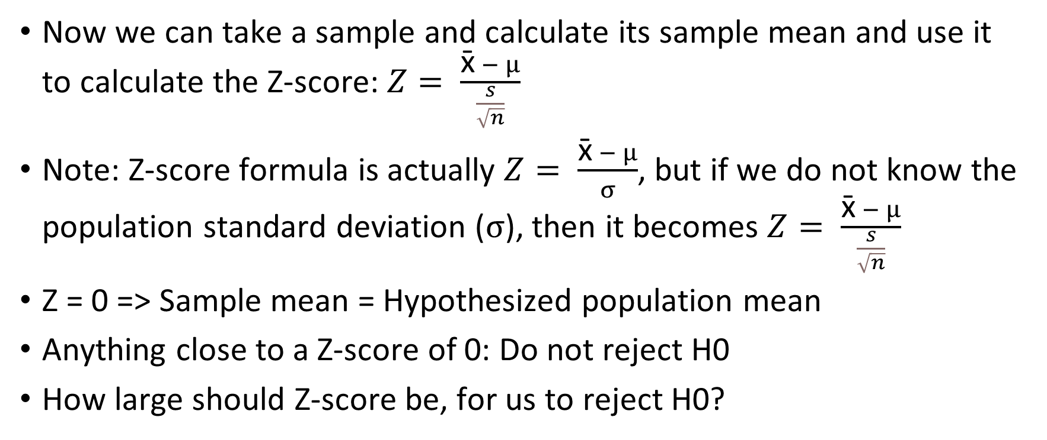
Significance Level
Now we can take a sample and calculate its sample mean and use it to calculate the Z-score: $Z= \frac{\text{x}\text{̄} − μ}{\frac{s}{\sqrt{n}}}$
Note: Z-score formula is actually $Z= \frac{\text{x}\text{̄} − μ}{σ}$, but if we do not know the population standard deviation ($σ$), then it becomes $Z= \frac{\text{x}\text{̄} − μ}{\frac{s}{\sqrt{n}}}$
Z = 0 => Sample mean = Hypothesized population mean
Anything close to a Z-score of 0: Do not reject H0
How large should Z-score be, for us to reject H0?

Slide 9
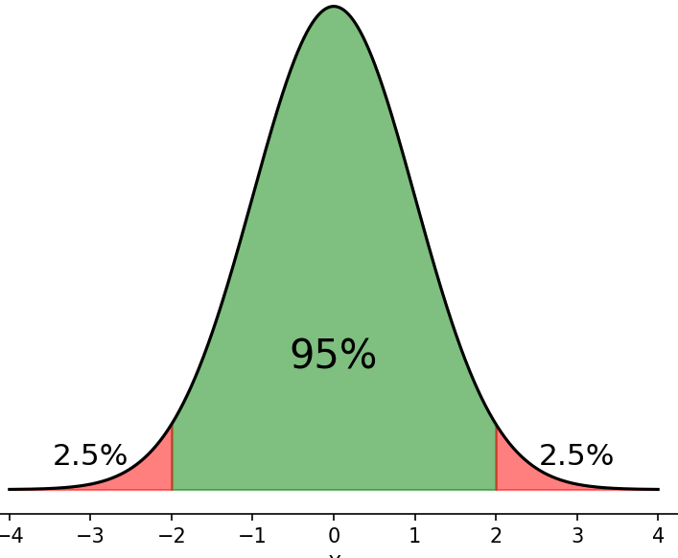
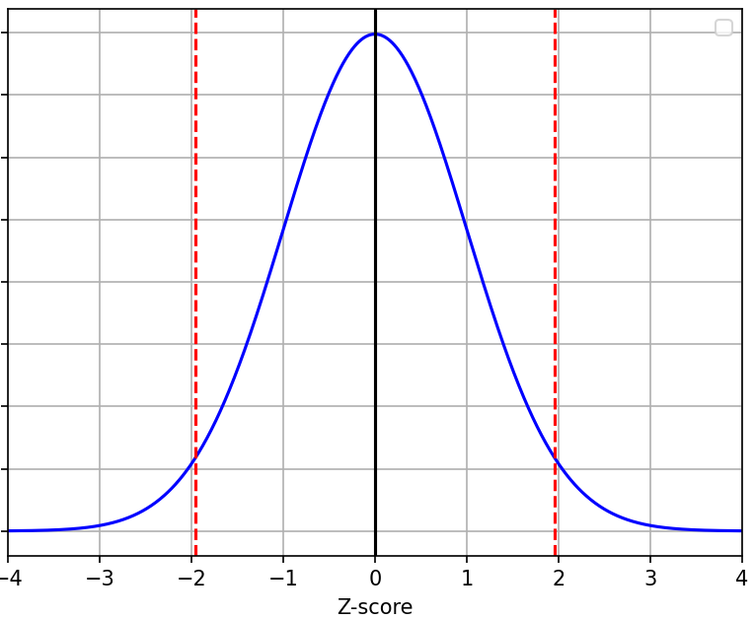
Significance Level
Critical values define the boundaries of the non-rejection zone for Z-scores … If our Z-score crosses this zone on either side, we reject H0 …
If Z-score is in the middle part, we do not reject H0
But if it goes beyond the dashed red lines, we reject H0 – Why?
Those are rejection regions (Critical zone)
Area of rejection regions depends on
significance level (alpha)
If alpha = 0.05, we have 0.0250 on both sides
From Z-table, when alpha = 0.0250,
critical value = 1.96 on RHS and -1.96 on LHS
So, if Z-score < -1.96 or > 1.96, reject H0
Non-Rejection zone
Rejection zone
Rejection zone

Slide 10
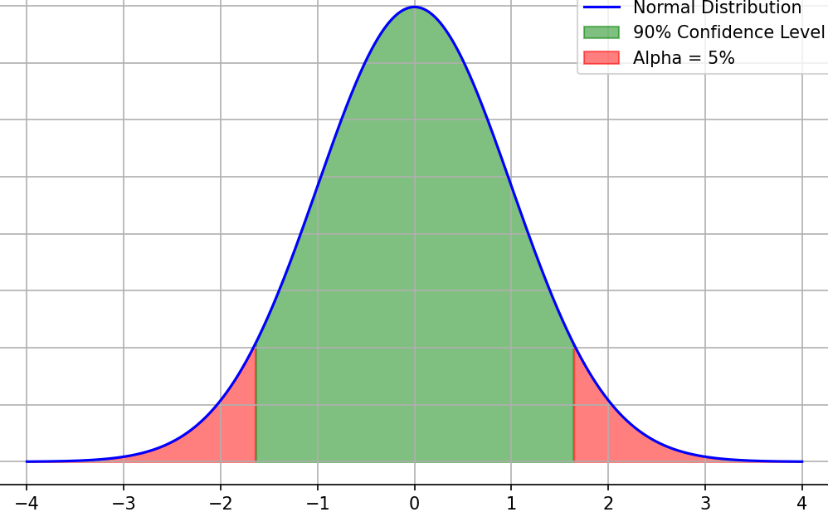
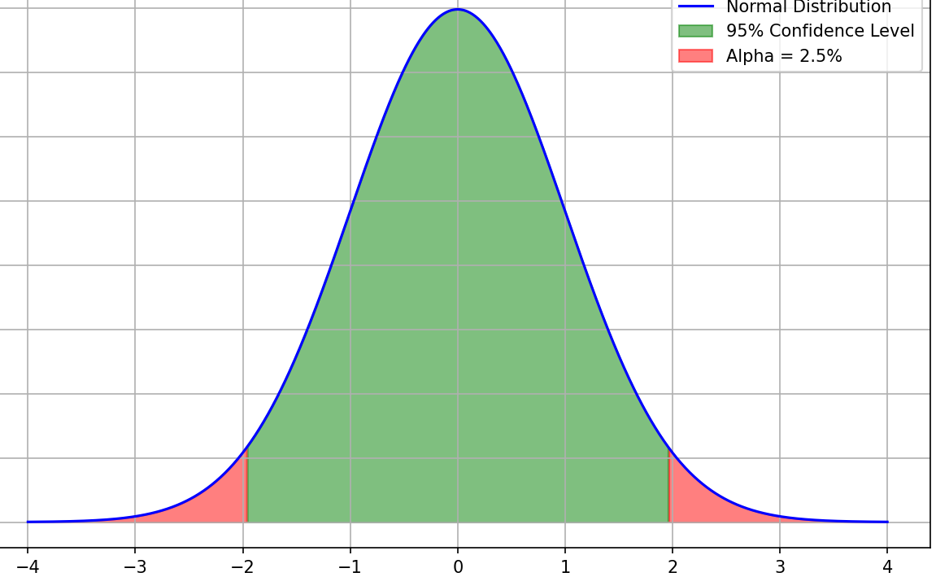
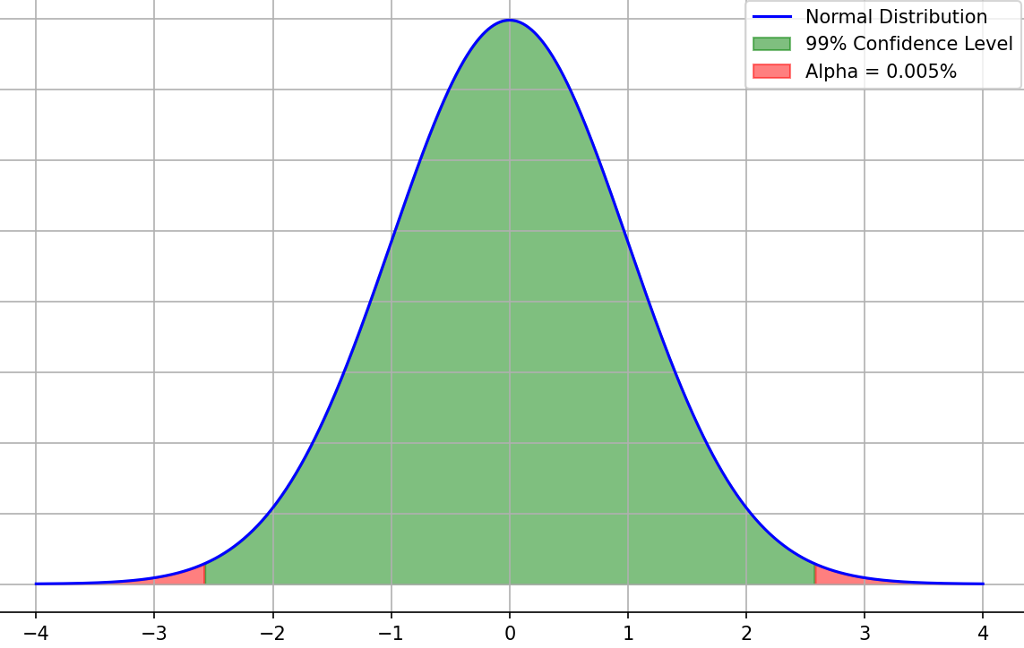
Significance Level and Confidence Level
As the confidence level increases, Critical Z-value increases
Range of acceptance level increases
Confidence level = 90%
Significance level (α) = 10%
Critical Z-Value = ±1.64
Confidence level = 95%
Significance level (α) = 5%
Critical Z-Value = ±1.96
Confidence level = 99%
Significance level (α) = 1%
Critical Z-Value = ±2.58

Slide 11
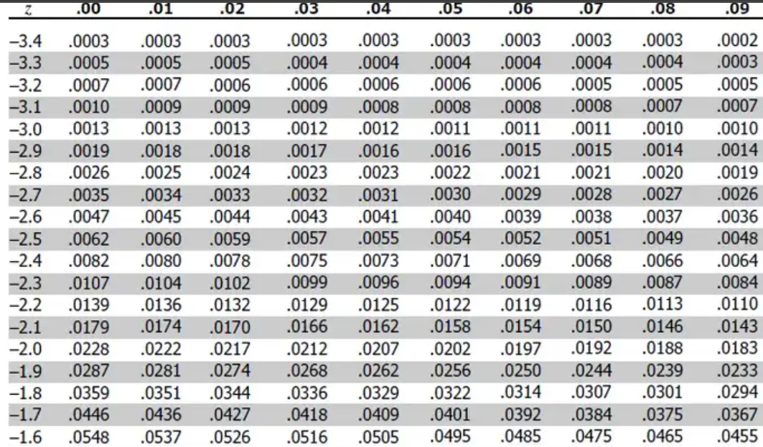
How to Get Critical Value from Z-Table
Look for our probability value
That is 0.025
Critical value = Row + Column
Critical value = 1.9 + .06
Critical value = 1.96
Note: If we look in the positive Z-table (the second table on the same page, we will need to look for 1 – 0.025, i.e. 0.975 and we will get the same result, i.e. 1.96)

Slide 12
Type I, II Errors, Alpha Beta
 | H0 is True | H0 is False
Reject H₀ | Type I Error, Alpha | Correct
Do not Reject H₀ | Correct | Type II Error, Beta
Why can this happen? Bad sample data …
Example: We got a bad sample where Average sample score = 80
We would reject H₀ because in our sample it seemed so, although in general it is true, considering all the other samples
Note: Try to reduce Type I errors => Try not to reject H₀ (See table above)
But it automatically means a scope for increase in Type II errors (See table above)

Slide 13
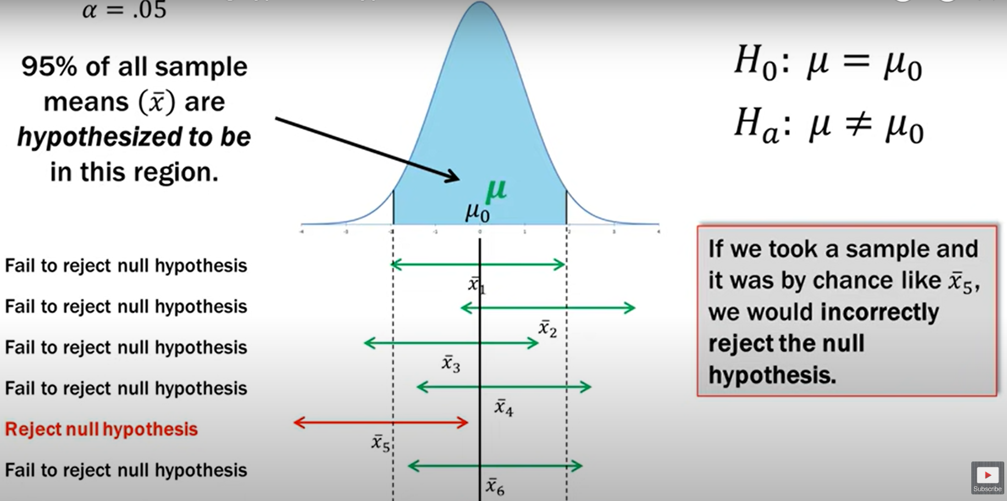
Visualizing Type I Errors
According to all the other samples, we will fail to reject H0, which is correct
Meaning: If by chance, the only sample we tested was x̄₅, we would commit Type I error
Type I error

Slide 14
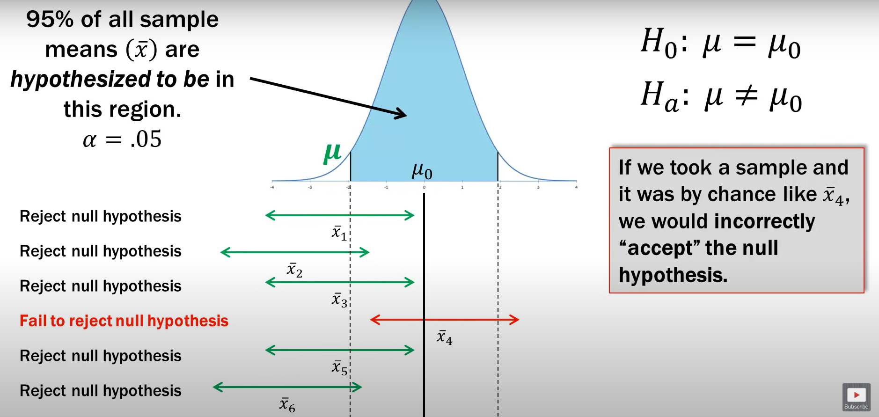
Similarly, Type II Error Now
According to all the other samples, we will reject H0, which is correct
Meaning: If by chance, the only sample we tested was x̄₄, we would commit Type II error

Slide 15
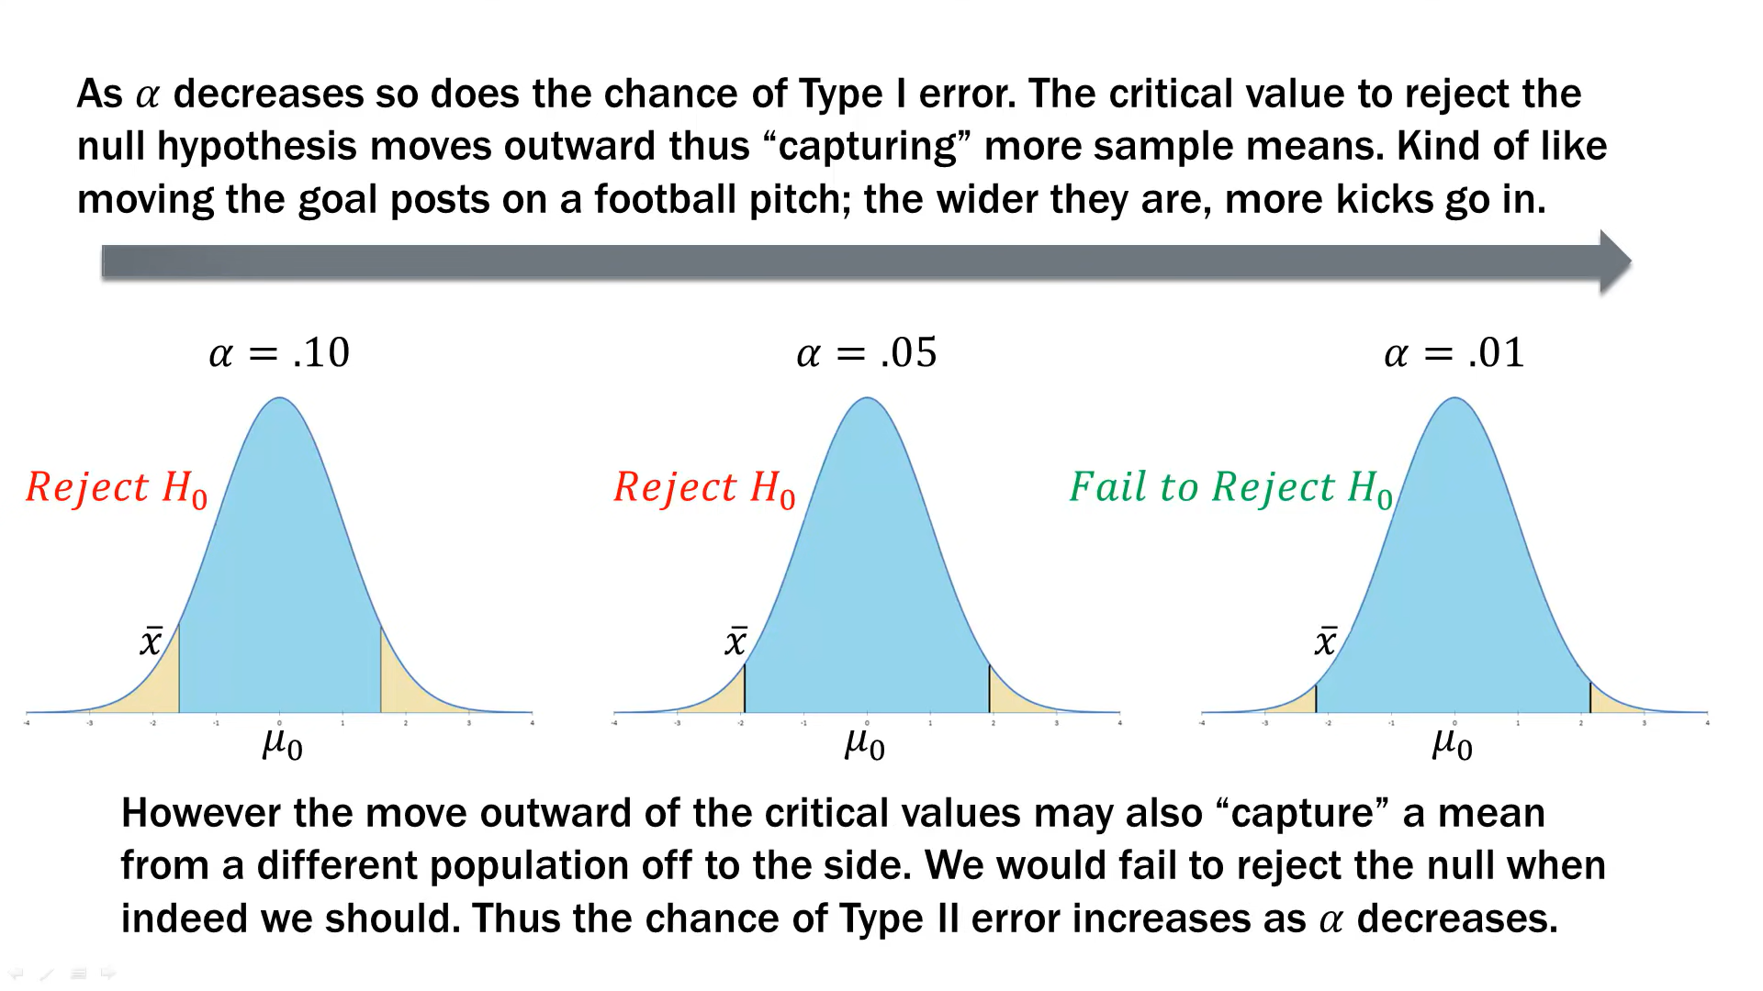

Slide 16
Type I and Type II Errors – Example
H₀: John’s used car is safe to drive
Possibilities
John thinks that his car may be safe when in fact it is not safe - Error
John thinks that his car may be safe when in fact it is safe - Ok
John thinks that his car may not be safe when in fact it is not safe - Ok
John thinks that his car may be not be safe when in fact it is safe – Error
Which of these is Type I and which is Type II Error?

Slide 17
Type I and Type II Errors – Example
H₀: John’s used car is safe to drive
Possibilities
John thinks that his car may be safe when in fact it is not safe - Error
John thinks that his car may be safe when in fact it is safe - Ok
John thinks that his car may not be safe when in fact it is not safe - Ok
John thinks that his car may be not be safe when in fact it is safe – Error
Which of these is Type I and which is Type II Error?
Remember:
Type I Error occurs when H₀ is true
Type II Error occurs when H₀ is false
In this example: H₀: John’s used car is safe to drive
So:
(d) is Type I error
(a) is Type II error
Which error is more serious?
Type II

Slide 18
Type I and Type II Errors – Another Example
In a criminal court case, H₀: The defendant is innocent
Possibilities:
The jury believes that the defendant is guilty when she is innocent - Error
The jury believes that the defendant is guilty when she is not innocent - Ok
The jury believes that the defendant is innocent when she is not innocent - Error
The jury believes that the defendant is innocent when she is innocent – Ok
What are Type I and Type II errors here, and which one is more dangerous?

Slide 19
Type I and Type II Errors – Another Example
In a criminal court case, H₀: The defendant is innocent
Possibilities:
The jury believes that the defendant is not innocent when she is innocent - Error
The jury believes that the defendant is not innocent when she is not innocent - Ok
The jury believes that the defendant is innocent when she is not innocent - Error
The jury believes that the defendant is innocent when she is innocent – Ok
What are Type I and Type II errors here, and which one is more dangerous?
Remember:
Type I Error occurs when H₀ is true
Type II Error occurs when H₀ is false
In this example: H₀: Defendant is innocent
(c) Type II error
(a) Type I error
Which one is more serious?
Perhaps (c), but then someone can also argue it is (a), depending on the situation and the crime

Slide 20
One-Tailed and Two-Tailed Tests
Two-tailed test: Rejection zone at both sides
One-tailed test: Rejection zone only in one side
Example: A new medicine is being tested with current lifespan = 70 years
Two-tailed Test
H0: Lifespan = 70
H1: Lifespan ≠ 70
One-tailed Test
H0: Lifespan = 70
H1: Lifespan > 70
C:\code\Data Analytics\One_tailed_Two_tailed.py, one_tailed_two_tailed_tips.py

Slide 21
Two-Tailed and One-Tailed Tests (Visualization: Next slide)
Two-tailed Test
H₀: The average weight of chips in a packet is equal to 50 grams (μ = 50)
Ha: The average weight of chips in a packet is not equal to 50 grams (μ ≠ 50)
Rejection zone: Both to the left and to the right of 50
One-Tailed Test (Left-Tailed)
H₀: The average weight of chips in a packet is equal to or greater than 50 grams (μ ≥ 50)
Ha: The average weight of chips in a packet is less than 50 grams (μ < 50)
Rejection zone: Towards the left side of 50
One-Tailed Test (Right-Tailed):
H₀: The average weight of chips in a packet is equal to or less than 50 grams (μ ≤ 50)
Ha: The average weight of chips in a packet is greater than 50 grams (μ > 50)
Rejection zone: Towards the right side of 50

Slide 22
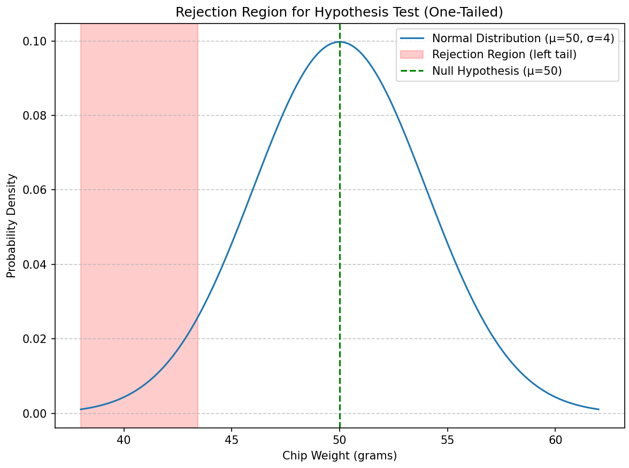
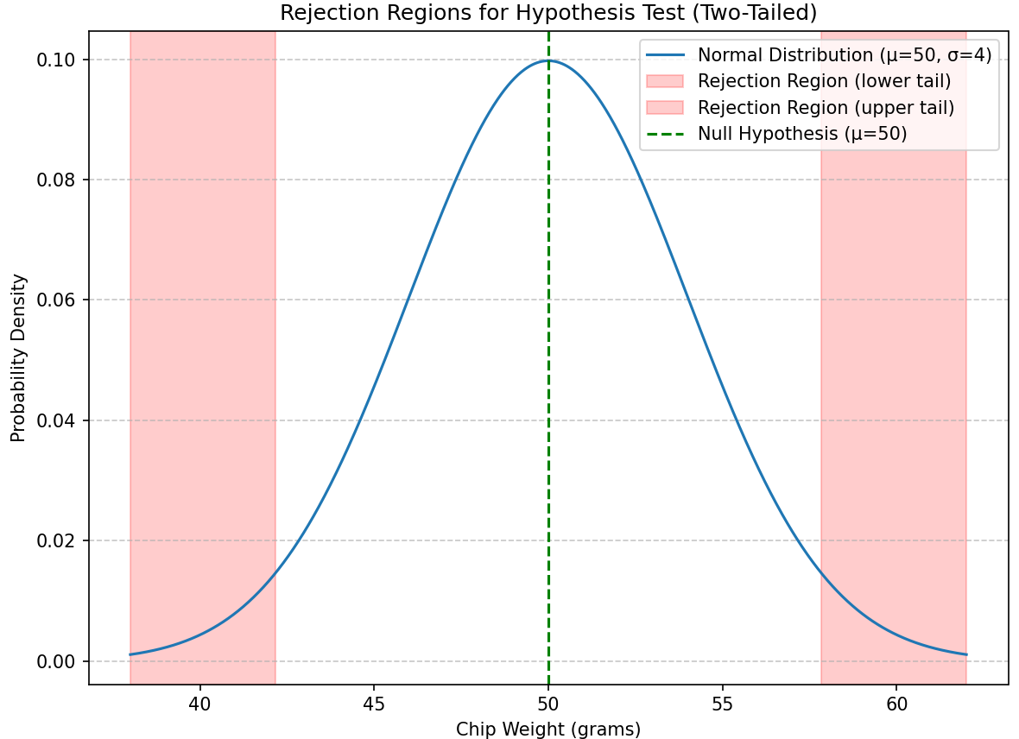
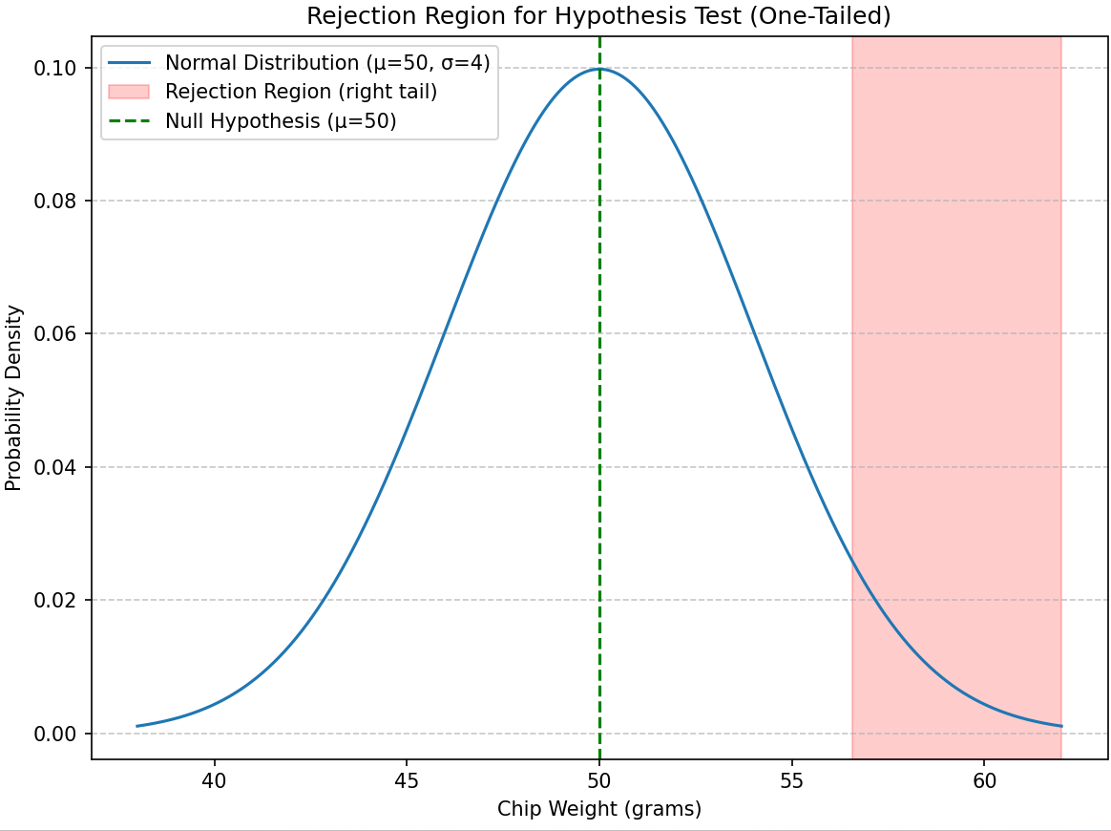
Two-Tailed and One-Tailed Tests

Slide 23
Rejection/Non-Rejection Criteria
Test Type | α | p-value
Two-tailed | Consider α/2 to find critical value | Compare p-value with α/2
One-tailed | Consider α to find critical value | Compare p-value with α
Test Type | Condition | Decision
Two-tailed | |Test-statistic| > |Critical Value| |Test-statistic| <= |Critical Value| | Reject H₀ Do not reject H₀
Left-tailed | Test-statistic < Critical value Test-statistic >= Critical value | Reject H₀ Do not reject H₀
Right-tailed | Test-statistic > Critical value Test-statistic <= Critical value | Reject H₀ Do not reject H₀

Slide 24
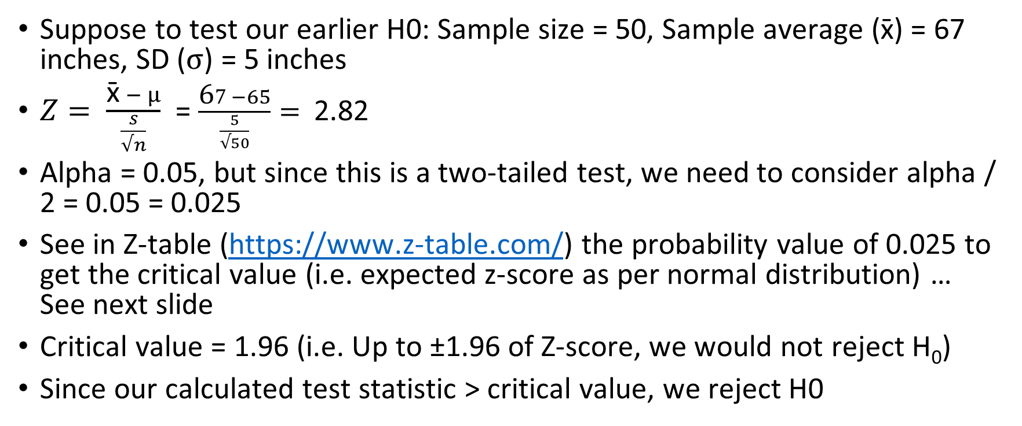
Calculate Test Statistic
Suppose to test our earlier H0: Sample size = 50, Sample average ($\text{x}\text{̄}$) = 67 inches, SD ($σ$) = 5 inches
$Z= \frac{\text{x}\text{̄} − μ}{\frac{s}{√n}}$ = $\frac{\text{6}7 −65}{\frac{5}{√50}}=$ 2.82
Alpha = 0.05, but since this is a two-tailed test, we need to consider alpha / 2 = 0.05 = 0.025
See in Z-table (https://www.z-table.com/) the probability value of 0.025 to get the critical value (i.e. expected z-score as per normal distribution) … See next slide
Critical value = 1.96 (i.e. Up to ±1.96 of Z-score, we would not reject H₀)
Since our calculated test statistic > critical value, we reject H0

Slide 25
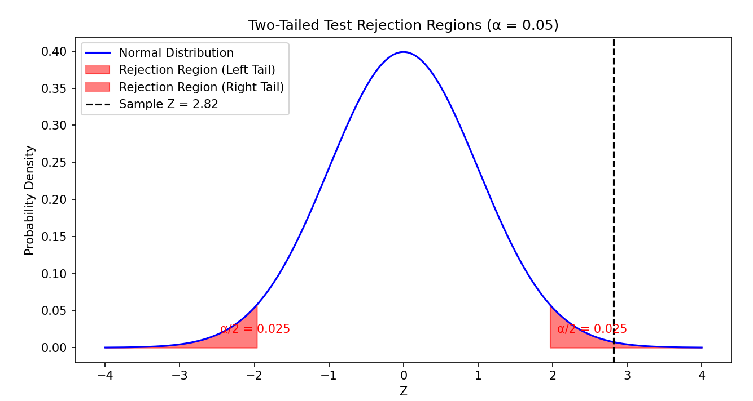
P-value Calculation Example
We have Z-Score = 2.82 for a two-tailed test
For Z-Score = 2.82, using Z-table, area under the curve = 0.9976
So, area to the right of Z = 2.82 = 1 - 0.9976 = 0.0024
Because it is a two-tailed test, P-value = 2 x 0.0024 = 0.0048
Since P-value < α, we do not reject H₀

Slide 26
P-value
P-value = Area of rejection
Low p-value: Reject H₀, High p-value: Fail to reject H₀
Example: A pizza outlet claims they deliver pizza in <= 30 minutes on average
H₀: Mean delivery time = 30 minutes
H_{a}: Mean delivery time <> 30 minutes
We test a few sample delivery times and get a p-value = 0.001
Since 0.001 is much less than 0.05, we reject H₀

Slide 27
Critical Values for Different Levels of α
Approximate Critical Values
α | Left-Tailed Test | Right-Tailed Test | Two-Tailed Test
0.1 | -1.28 | +1.28 | -1.64 and + 1.64
0.05 | -1.64 | +1.64 | -1.96 and + 1.96
0.01 | -2.33 | +2.33 | -2.58 and + 2.58

Slide 28
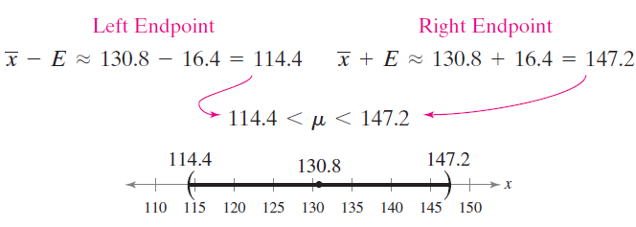
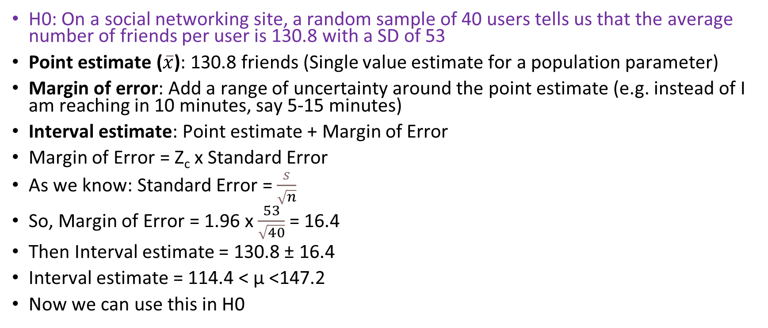
Margin of Error
H0: On a social networking site, a random sample of 40 users tells us that the average number of friends per user is 130.8 with a SD of 53
Point estimate ($\overline{x}$): 130.8 friends (Single value estimate for a population parameter)
Margin of error: Add a range of uncertainty around the point estimate (e.g. instead of I am reaching in 10 minutes, say 5-15 minutes)
Interval estimate: Point estimate + Margin of Error
Margin of Error = Z_{c} x Standard Error
As we know: Standard Error = $\frac{s}{\sqrt{n}}$
So, Margin of Error = 1.96 x $\frac{53}{\sqrt{40}}$ = 16.4
Then Interval estimate = 130.8 ± 16.4
Interval estimate = 114.4 < μ <147.2
Now we can use this in H0

Slide 29

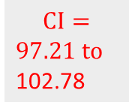




Confidence Interval Confidence Level
* Calculate MoE and CI as shown on the previous slide, for each sample
Interval Estimate = 114.4 to 147.2
Confidence interval = Calculate for each sample*
Confidence level = Confidence about the confidence interval
95% confidence level means: If we take 100 samples, calculate sample mean, calculate sample CI* around the sample mean, 95% of such sample CIs would contain the true/hypothesized value of the population mean (μ)
H₀: Average number of friends for a user = 114.4 to 147.2
Sample 1
Sample 2
…
Sample 100
Now if we take 100 more samples
Calculate CI for each sample mean
We expect 95% of these CIs to contain μ (true or hypothesized)
$$\overline{x}=125,$$
$$σ=12$$
$$\overline{x}=132,$$
$$σ=23$$
$\overline{x}$ = 100, $σ=9$
$$CI=$$
$121.28 to$ 128.71
$$CI=$$
$124.87 to$ 139.12
$$CI=$$
$97.21 to$ 102.78
✓
✓
X

Slide 30
Null Hypothesis – How to State?
Test | Null Hypothesis
One-sample T-Test | There is no significant difference between the sample mean and the hypothesized population mean
Two-sample T-Test | The population means of the two groups are equal
Paired T-Test | The means before and after of the same group are equal
ANOVA | The means of more than two groups are equal
Chi-Square Test | There is no association between the two categorical variables (they are independent)
Linear regression | The coefficients of the independent variables are equal to zero (no relationship)
Logistic regression | There is no association between the independent variables and the binary outcome

Slide 31
t-tests
t-test: Also called student’s t-test
Determines if there is a significant difference between the means of two samples
Difference from Z-test: Here, the sample size is expected to be <= 30
Types
Type of the t-test | Purpose
One sample t-test | Compare the mean of a sample with that of the population
Independent sample t-test | Compare the mean of two different populations
Paired sample t-test | Compare the mean of the same group at different times

Slide 32
One-Sample T-test

Slide 33
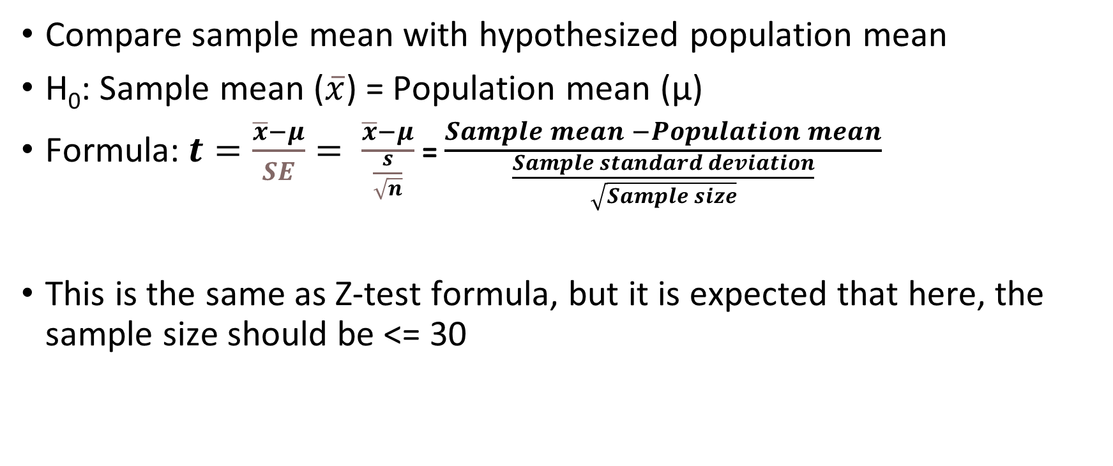
One-Sample T-test
Compare sample mean with hypothesized population mean
H₀: Sample mean ($\overline{x}$) = Population mean (μ)
Formula:$t=\frac{\overline{x}−μ}{SE}= \frac{\overline{x}−μ}{\frac{s}{\sqrt{n}}}$ = $\frac{Sample mean −Population mean}{\frac{Sample standard deviation}{\sqrt{Sample size}}}$
This is the same as Z-test formula, but it is expected that here, the sample size should be <= 30

Slide 34
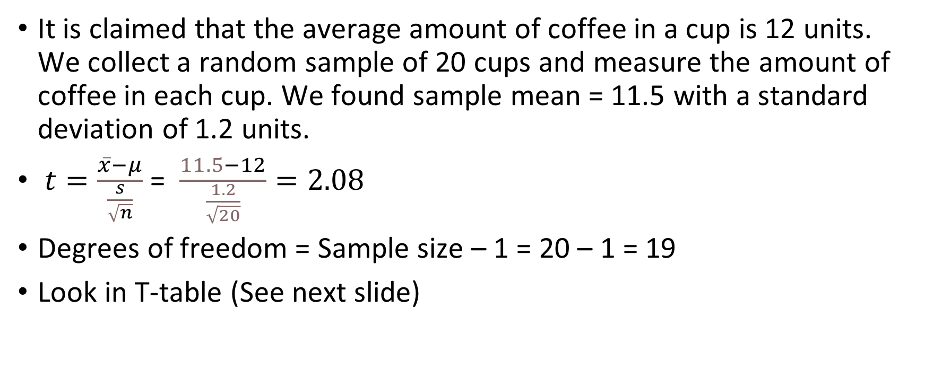
One-Sample T-test : Example
It is claimed that the average amount of coffee in a cup is 12 units. We collect a random sample of 20 cups and measure the amount of coffee in each cup. We found sample mean = 11.5 with a standard deviation of 1.2 units.
$t=\frac{\overline{x}−μ}{\frac{s}{\sqrt{n}}}$ = $\frac{11.5−12}{\frac{1.2}{\sqrt{20}}}=2.08$
Degrees of freedom = Sample size – 1 = 20 – 1 = 19
Look in T-table (See next slide)

Slide 35
One-Sample T-test : Example
T-table: At https://www.sjsu.edu/faculty/gerstman/StatPrimer/t-table.pdf, look for DF 19 and two-tails value of 0.05
Why 0.05? Because confidence interval is 95%, so significance level (alpha) is 0.05
Calculated t-statistic (2.08) < Critical t-value (2.093)
Conclusion: Fail to reject the null hypothesis
Conclusion: We do not have enough evidence to conclude that the average amount of coffee in a medium-sized cup served by the company is different from 12 units

